Slide 1
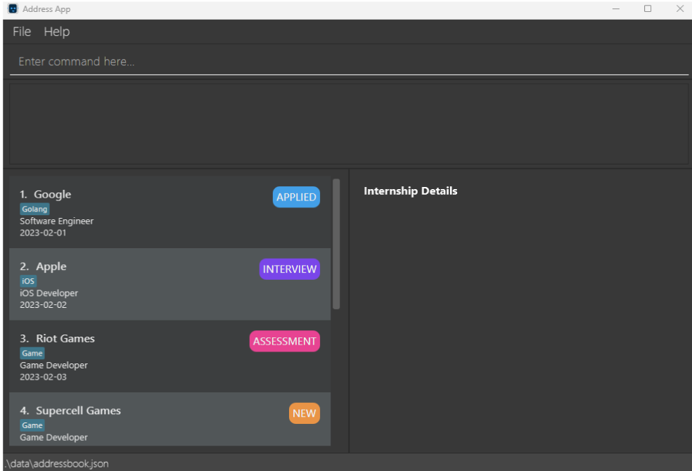
Command Box where you can type in your desired commands
Menu Bar
Results Display where the results of running your commands are displayed
Internship List that contains all your internship entries
Entry Display where the information of the selected internship entry is shown
File Location which states which folder is your InternBuddy data is stored in

Slide 2
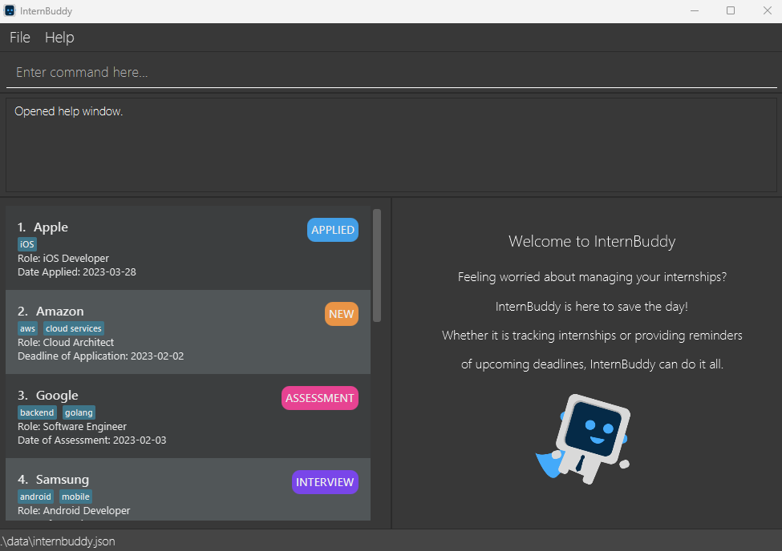

Slide 3
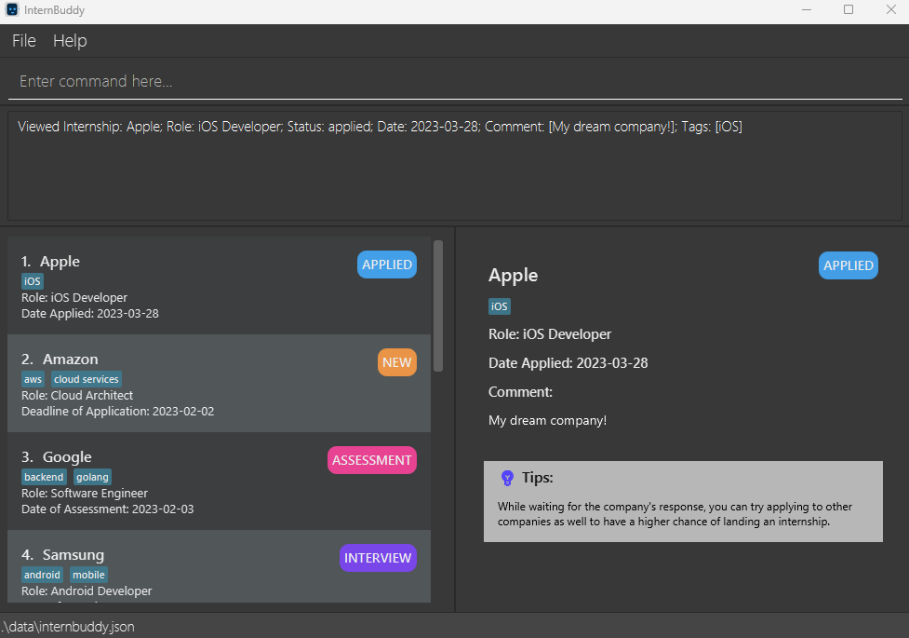
Command Box
Result Display
List Panel
View Panel
Status Bar

Slide 4
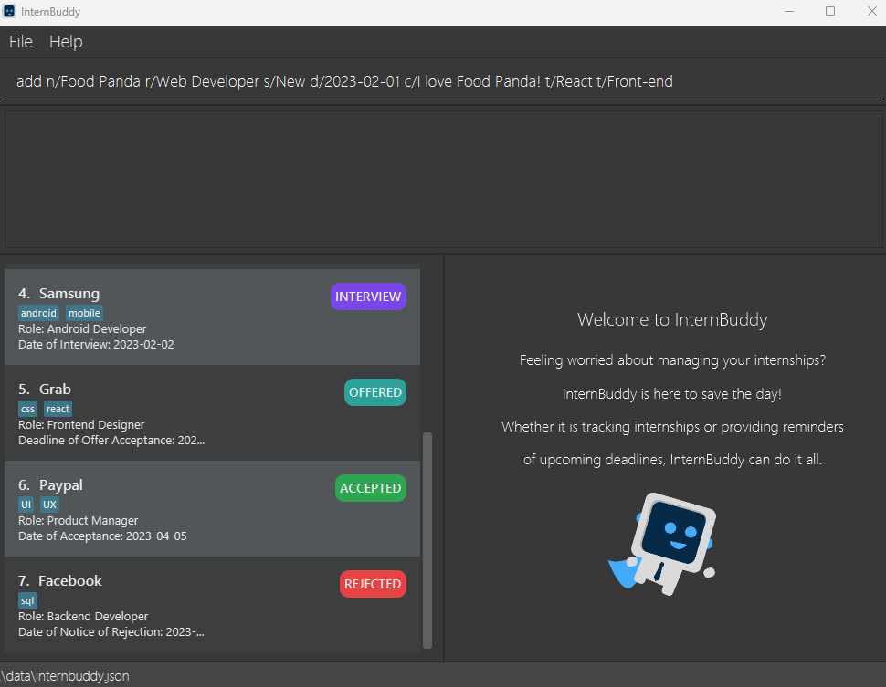
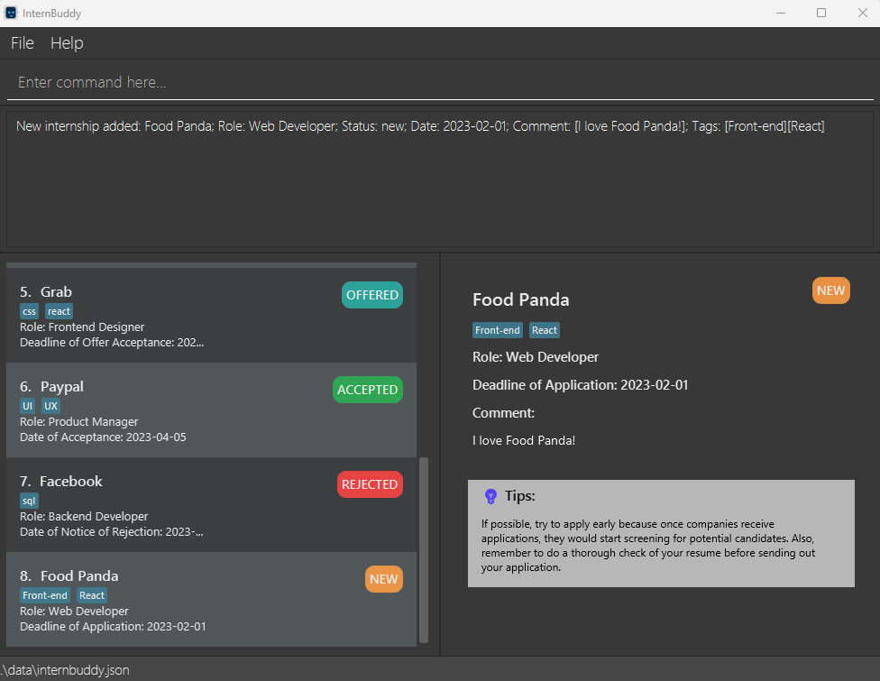
Before
After
New entry added in List Panel
View Panel displays details for the new internship

Slide 5
After the command
add n/Food Panda r/Web Developer s/New d/2023-02-01 c/I love Food Panda! t/React t/Front-end
New entry added in List Panel
View Panel displays details for the new internship

Slide 6
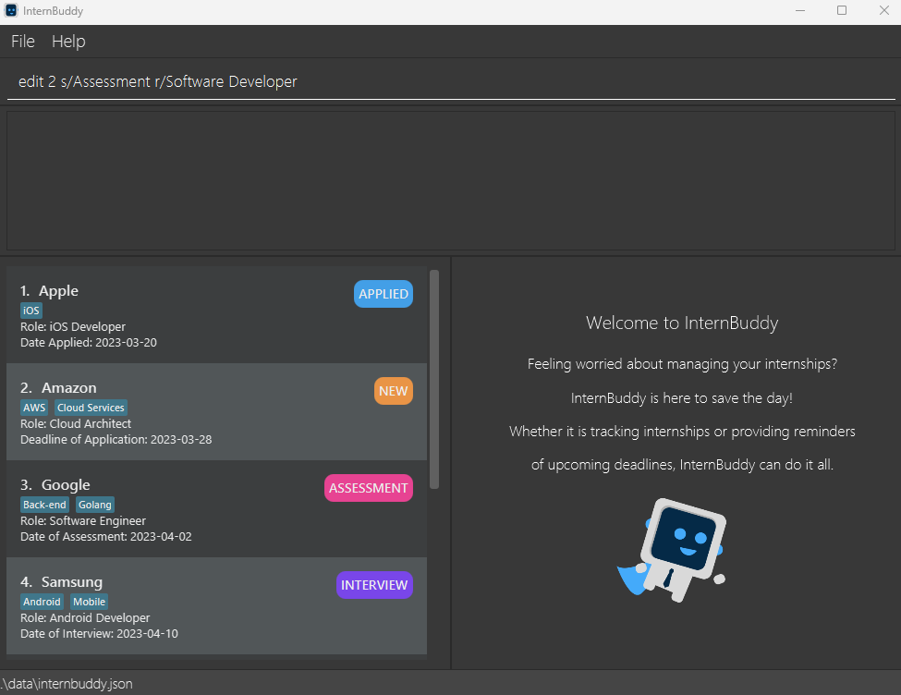
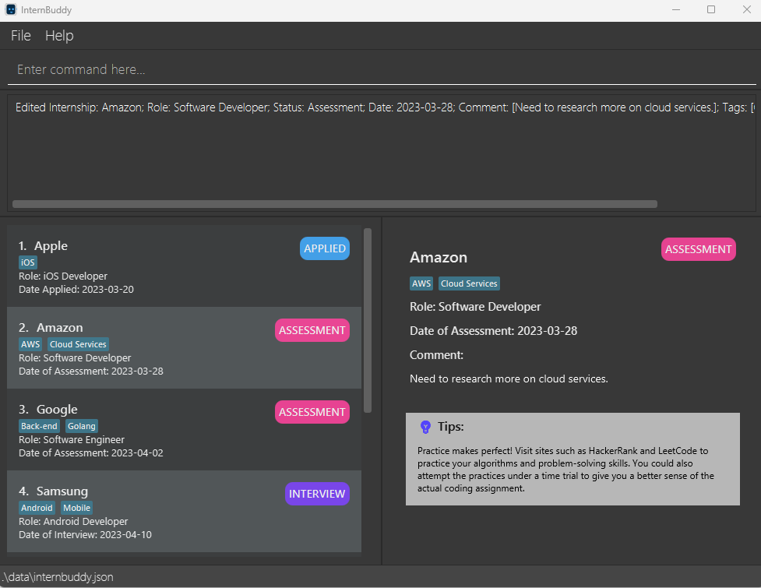
Before
After

Slide 7
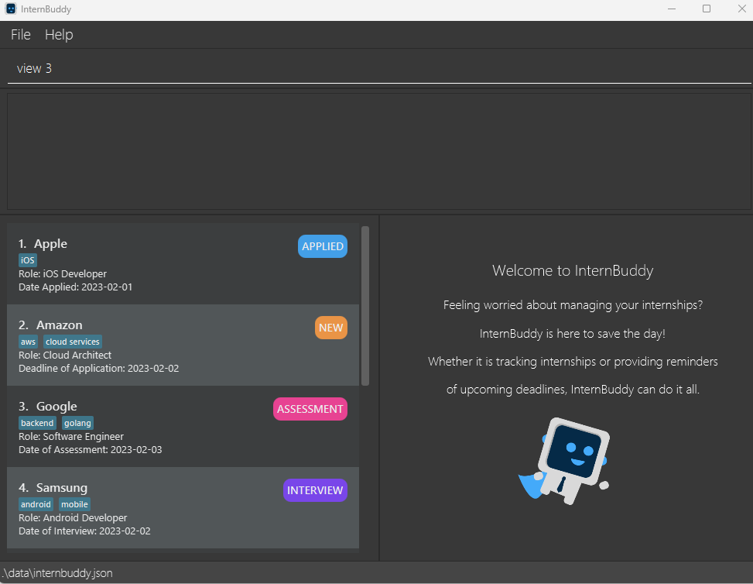
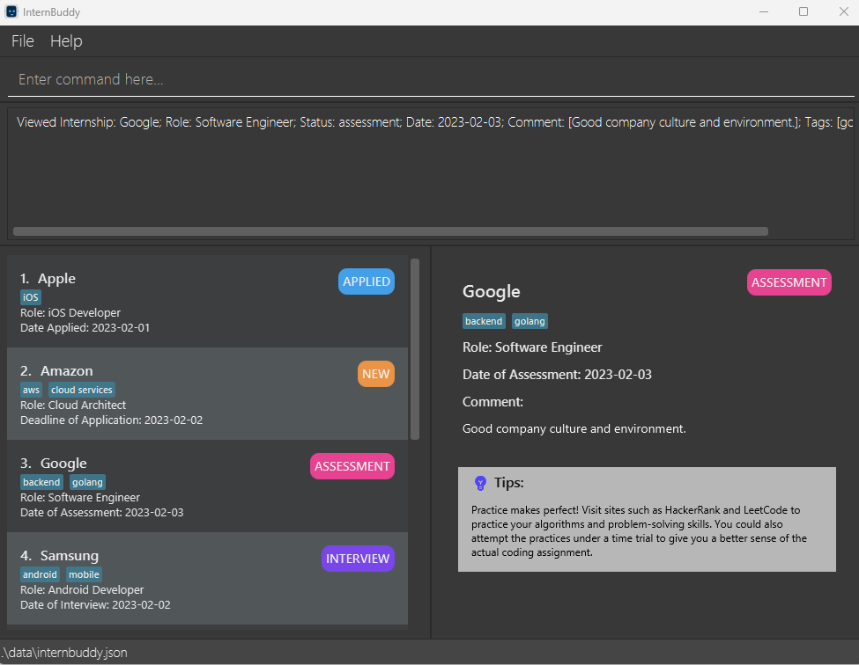
Before
After
View Panel displays details for the selected internship, with a custom tips box.

Slide 8
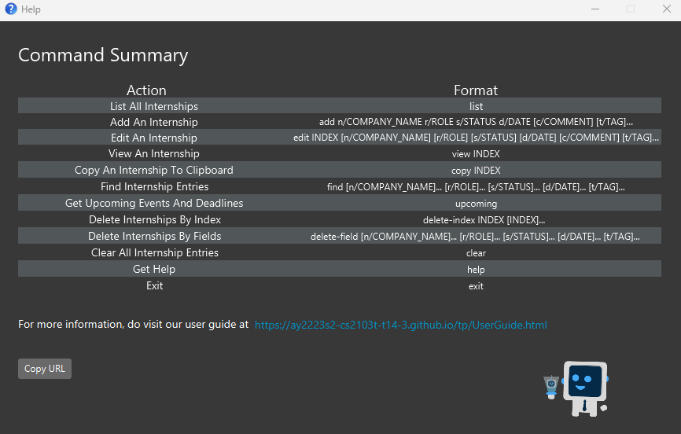

Slide 9
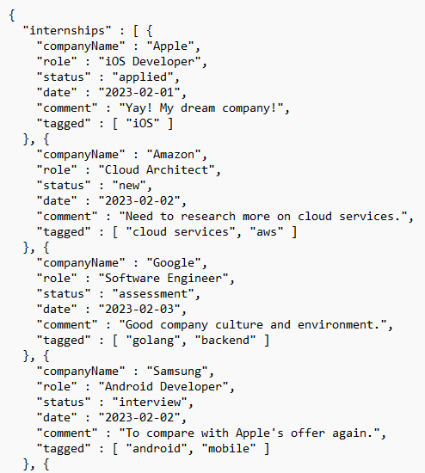
Field
Value

Slide 10
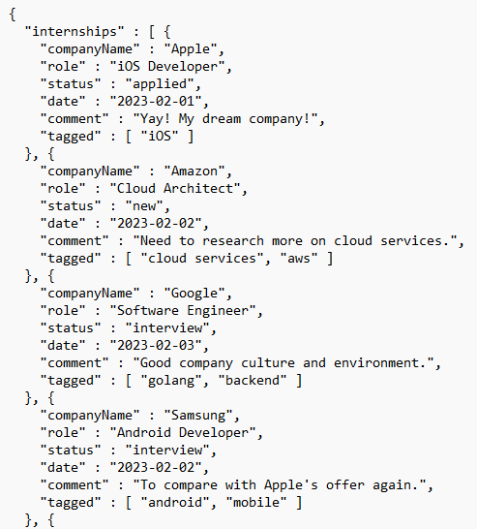
Before
After

Slide 11
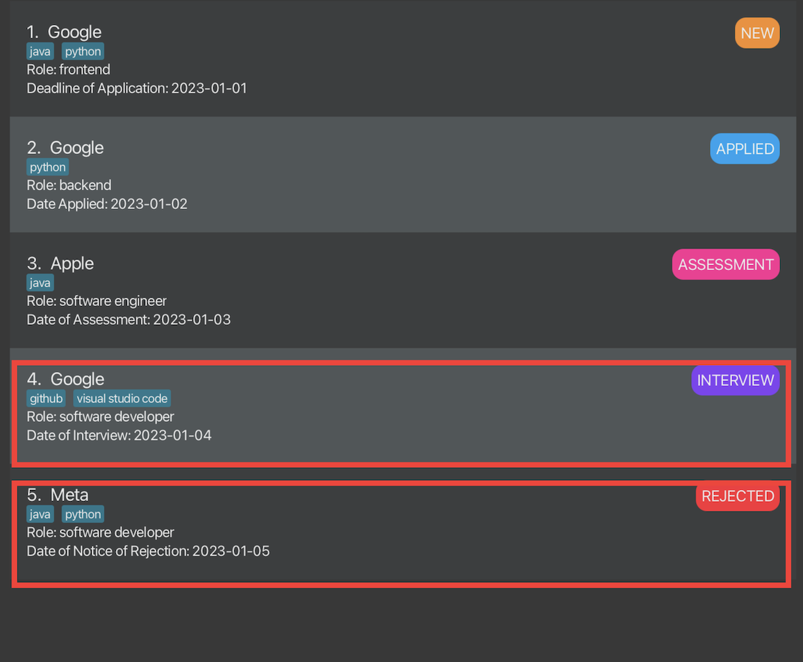
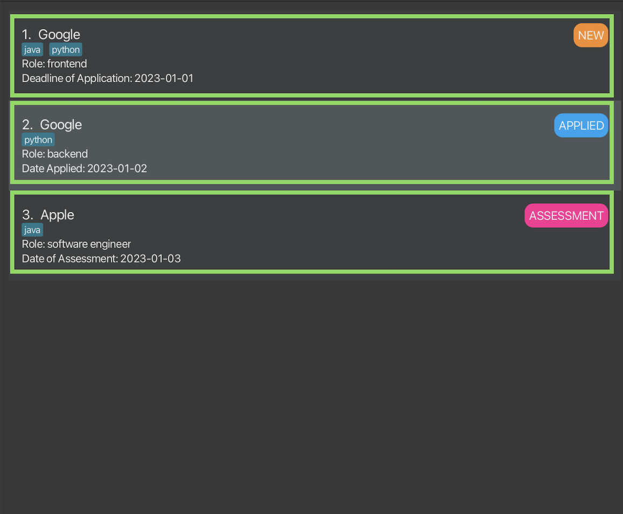
Full list before entering find command
After entering 'find n/Google n/Apple t/python t/java'

Slide 12
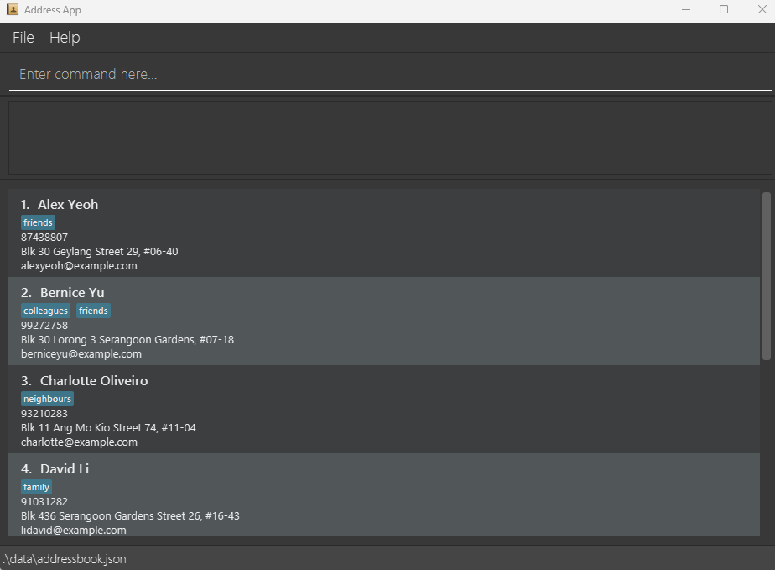
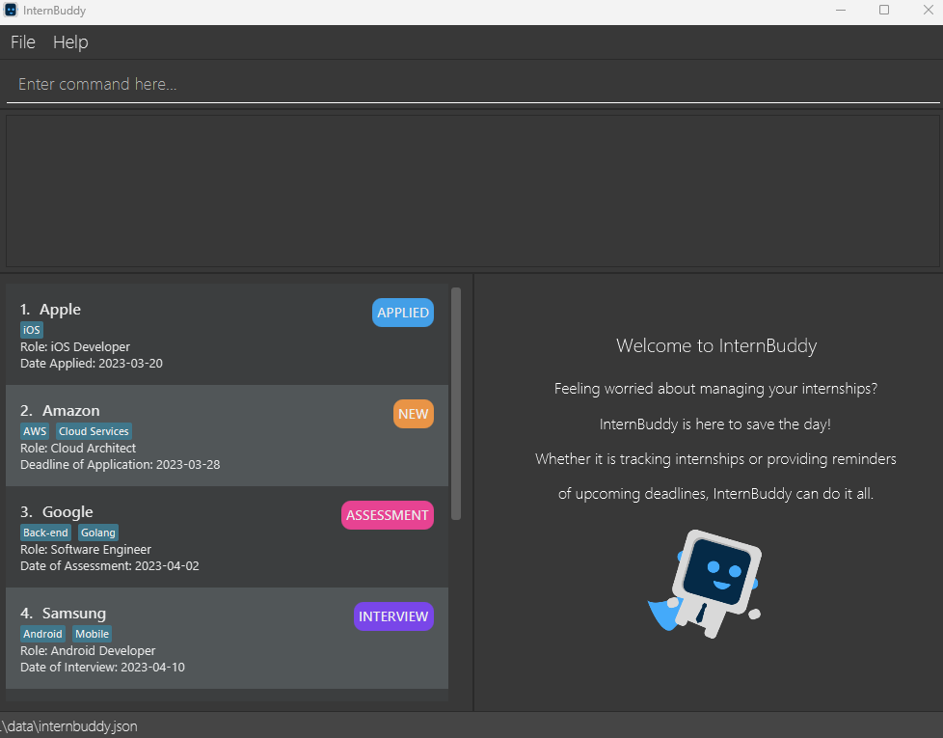
Before
After
Redesigned List Panel
Implemented View Panel

Slide 13
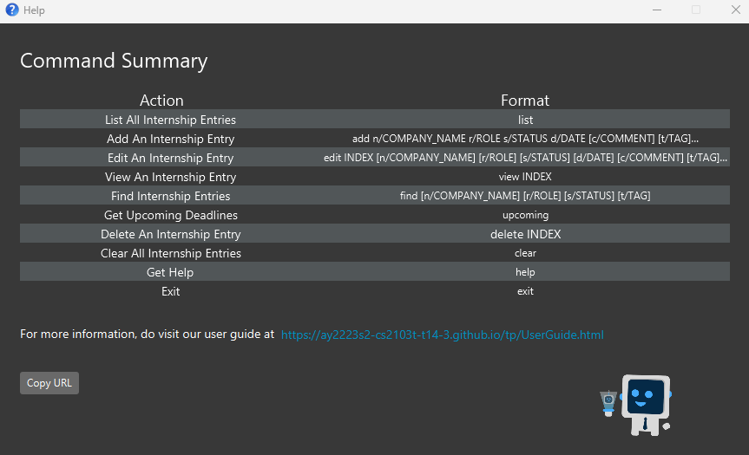

Before
After

Slide 14

list
help
upcoming
1st command entered
2nd command entered
3rd command entered

Slide 15
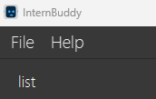
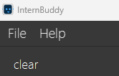
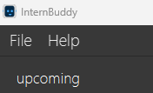
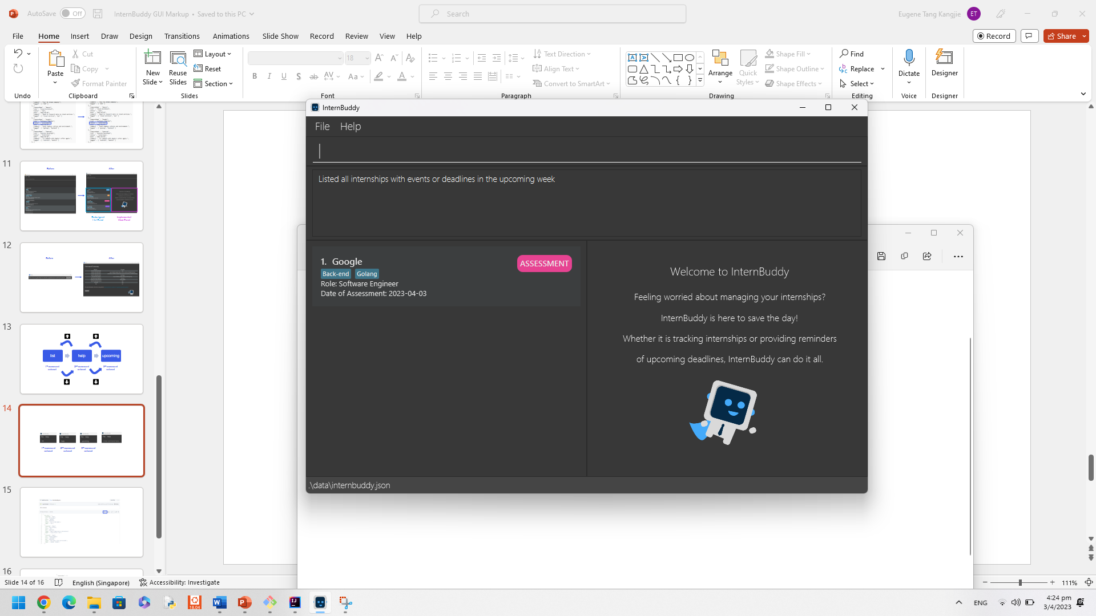
1st input
2nd input
3rd input
Currently waiting for new input

Slide 16
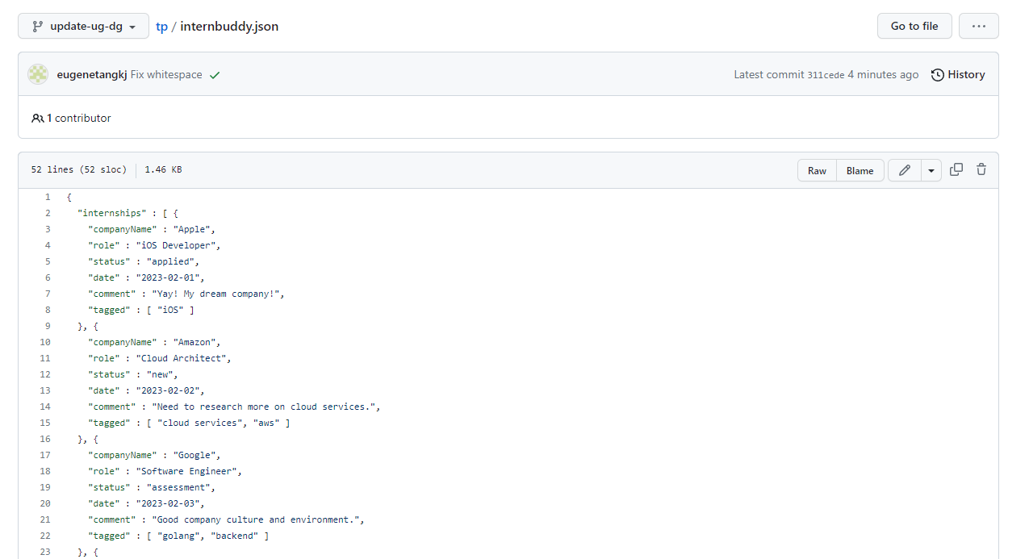

Slide 17
